Slide 1

Neural Substrates of Attention and Awareness
Dan Birman
Gardner Lab
Frisem – 2015-04-17

Slide 4


Slide 5
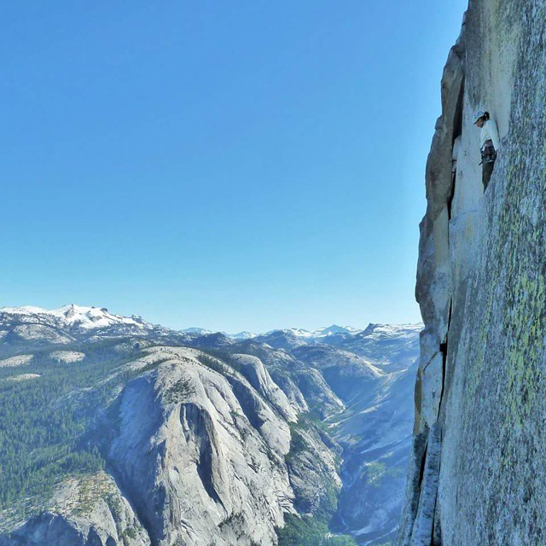

Slide 8
Neural Substrates of Attention and Awareness
Dan Birman
Gardner Lab
Frisem – 2015-04-17

Slide 11


Slide 12


Slide 13
Attention as a Pre-Requisite to Awareness
Dual task designs “pull” attention to one task, causing inattentional blindness for other stimuli.
“we believe […] there is no conscious perception without attention” (Mack & Rock, 1998)

Slide 14
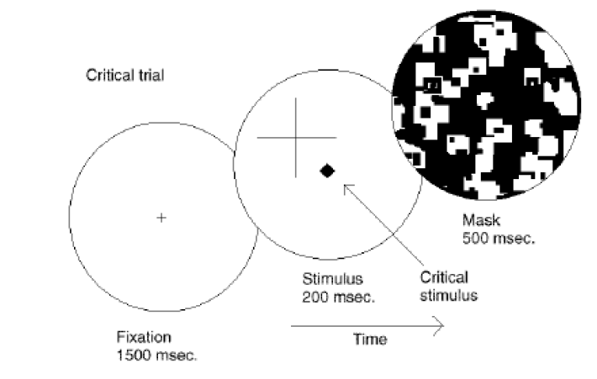
Attention as a Pre-Requisite to Awareness
Dual task designs “pull” attention to one task, causing inattentional blindness for other stimuli.
“we believe […] there is no conscious perception without attention” (Mack & Rock, 1998)
Mack & Rock, 1998
Notes:
There is one situation where attention (seems) to not be a pre-requisite for awareness

Slide 15
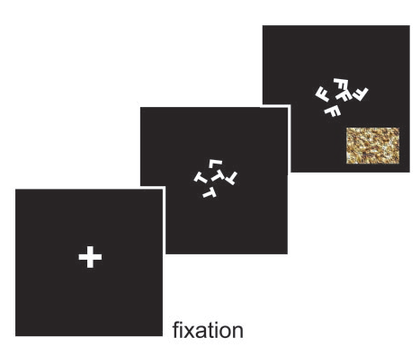
Gist Perception
“The close relationship between attention and
consciousness has led many scholars to conflate these processes“ (Koch & Tsuchiya, 2006)
Li et al., 2002

Slide 16
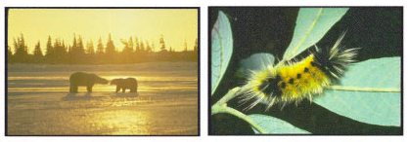
Gist Perception
“The close relationship between attention and
consciousness has led many scholars to conflate these processes“ (Koch & Tsuchiya, 2006)
Li et al., 2002

Slide 17
Gist Perception vs. Inattentional Blindness

Slide 18
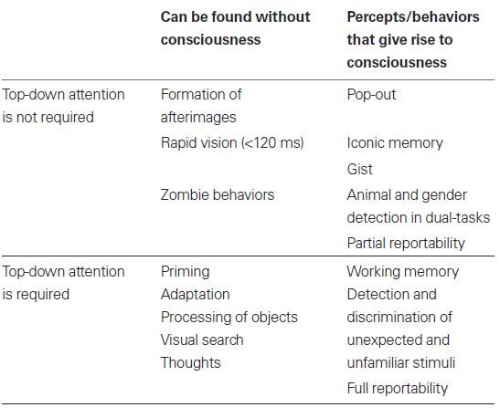
P
Perception of Stimulus:
Unaware
Aware
Unattended
Stimulus Is:
A
Attended

Slide 19
P
Perception of Stimulus:
Unaware
Aware
Unattended
Stimulus Is:
A
Attended
Normal Vision

Slide 20
P
Perception of Stimulus:
Unaware
Aware
Unattended
Gist Perception
Stimulus Is:
A
Attended
Normal Vision

Slide 21
P
Perception of Stimulus:
Unaware
Aware
Unattended
Inattentional
Blindness
Gist Perception
Stimulus Is:
A
Attended
Normal Vision

Slide 22
P
Jumble of Phenomena
Perception of Stimulus:
Unaware
Aware
Unattended
Inattentional
Blindness
Gist Perception
Stimulus Is:
A
Attended
Continuous Flash
Suppression
Normal Vision

Slide 23
P
Perception of Stimulus:
Unaware
Aware
Unattended
Inattentional
Blindness
Gist Perception
Stimulus Is:
A
Attended
Normal Vision

Slide 24
P
Perception of Stimulus:
Unaware
Aware
Unattended
Inattentional
Blindness
Gist Perception
Stimulus Is:
A
Attended
Normal Vision

Slide 25
P
Perception of Stimulus:
Unaware
Aware
Unattended
Inattentional
Blindness
Gist Perception
Trajectory Depends on
Interaction Between
Stimuli
Stimulus Is:
A
Attended
Normal Vision

Slide 26
P
Perception of Stimulus:
Unaware
Aware
Unattended
Stimulus Is:
A
Attended

Slide 27
P
Perception of Stimulus:
Unaware
Aware
Catch:
Unattended
Stimulus Is:
A
Cued:
Attended

Slide 28
P
Perception of Stimulus:
Perceptually Identical:
Unaware
Perceptually Distinct:
Aware
Catch:
Unattended
Stimulus Is:
A
Cued:
Attended

Slide 29
P
Perception of Stimulus:
Perceptually Identical:
Unaware
Perceptually Distinct:
Aware
Catch:
Unattended
Stimulus Is:
A
Cued:
Attended

Slide 30
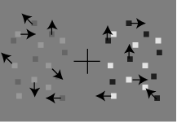
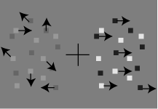
P
Perception of Stimulus:
Perceptually Identical:
Unaware
Perceptually Distinct:
Aware
Catch: Coherence
Unattended
Stimulus Is:
A
Cued: Contrast
Attended

Slide 31
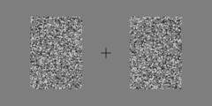
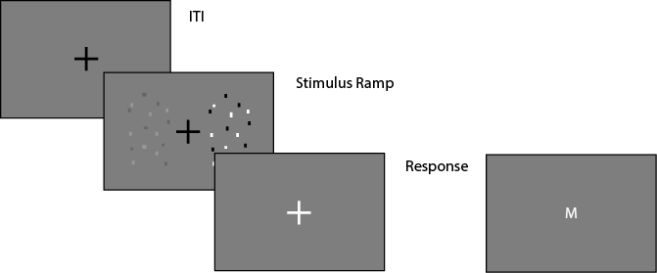
Task Design

Slide 32
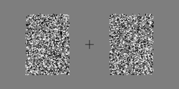
Task Design

Slide 33
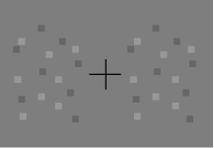
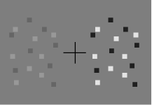
P
Perception of Stimulus:
Perceptually Identical:
Unaware
Perceptually Distinct:
Aware
Catch: Coherence
Unattended
Stimulus Is:
A
Cued: Contrast
Attended

Slide 34
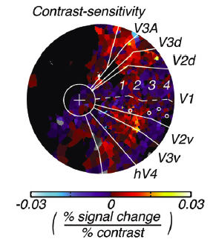
Contrast
Todo: Replace w/ my brain pictures
(and de-convolved data? Or glm betas?
Notes:
First attempt: dual

Slide 35
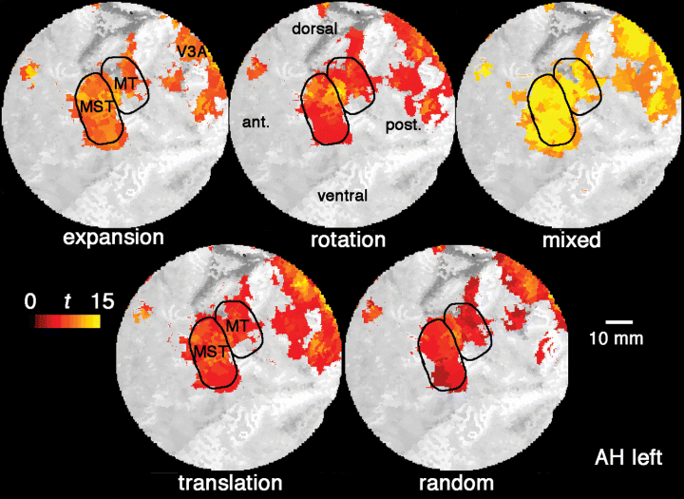
Contrast and Coherence
Todo: Replace w/ my brain pictures
(and de-convolved data? Or glm betas?
Notes:
First attempt: dual

Slide 36
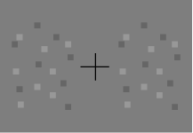
Neural Substrate of Awareness
100%
Performance (%)
50%
.44 .88 1.75 3.5 7 14 28
Difference in Stimulus Strength

Slide 37
A Proxy for Awareness
Performance (%)
Difference in Stimulus Strength

Slide 38
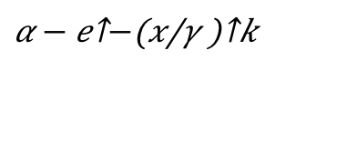
A Proxy for Awareness
$$α − e^{−{\left(\frac{x}{γ}\right)}^{k}}$$
Performance (%)
Difference in Stimulus Strength

Slide 39
A Proxy for Awareness
~80% Performance
Performance (%)
11% Contrast
Discrimination Threshold
Difference in Stimulus Strength

Slide 40
A Proxy for Awareness

Slide 41
A Proxy for Awareness

Slide 42
A Proxy for Awareness
Easier

Slide 43
A Proxy for Awareness

Slide 44
P
Perceptually Identical:
Unaware
Perceptually Distinct:
Aware
Catch: Coherence
Unattended
A
Cued: Contrast
Attended

Slide 45
P
Perceptually Identical:
Unaware
Perceptually Distinct:
Aware
Catch: Coherence
Unattended
A
Cued: Contrast
Attended

Slide 46
Effect of Attention

Slide 47
Effect of Attention
Performance (%)
Difference in Stimulus Strength

Slide 48
Effect of Attention
Unaware:
No Discrimination
Aware:
Can Discriminate
Performance (%)
Difference in Stimulus Strength

Slide 49
Effect of Attention
Performance (%)
Difference in Stimulus Strength

Slide 50
Effect of Attention
Performance (%)
Difference in Stimulus Strength

Slide 51

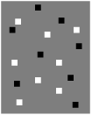
Effect of Attention
Bold Response Magnitude
Performance (%)
Difference in Stimulus Strength

Slide 52
Effect of Attention
Bold Response Magnitude
Performance (%)
Difference in Stimulus Strength

Slide 53
Effect of Attention
Bold Response Magnitude
Performance (%)
Difference in Stimulus Strength

Slide 54
Effect of Attention
Bold Response Magnitude
Performance (%)
Difference in Stimulus Strength

Slide 55
Effect of Attention
Bold Response Magnitude
Performance (%)
Difference in Stimulus Strength

Slide 56
Effect of Attention
Bold Response Magnitude
Performance (%)
Difference in Stimulus Strength

Slide 57
P
Effect of Attention
Cued: Contrast
Catch: Coherence
Effect
A

Slide 58
P
Effect of Attention
Catch: Contrast
Cued: Coherence
Effect
A

Slide 59
P
Effect of Attention
Perceptually Identical:
Unaware
Perceptually Distinct:
Aware
Catch: Coherence
Unattended
A
Cued: Contrast
Attended

Slide 60
Gist Perception vs. Inattentional Blindness

Slide 61
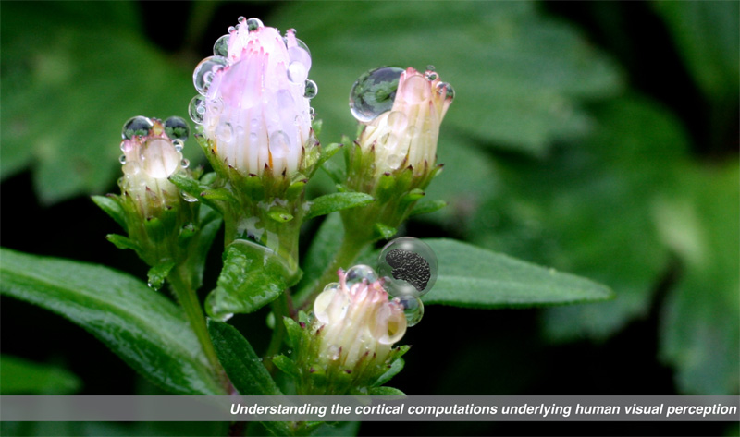

Gardner Lab @ Stanford University
Thank You!
Justin Gardner
Steeve Laquitaine
1st Year Cohort

Slide 62
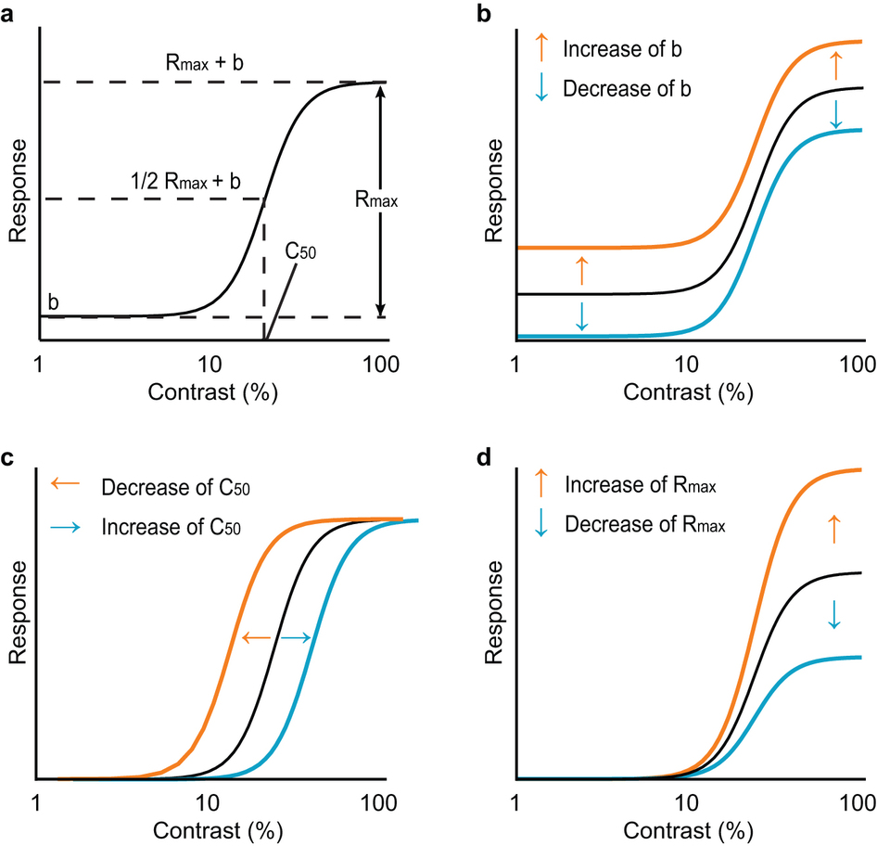
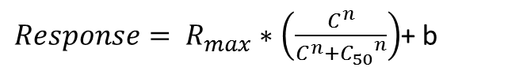
$Response= R_{max}∗\left(\frac{C^{n}}{C^{n}+{C_{50}}^{n}}\right)$+ b
Baseline Shift
Response Gain
Contrast Gain
Soma et al. 2013

Slide 63
Behavior in the Scanner
Outside
Inside Scanner

